Slide 1
Intermediate COCOMO model
The basic COCOMO model assumes that effort and development time are functions of the product size alone.
However, a host of other project parameters besides the product size affect the effort required to develop the product as well as the development time.
Therefore, in order to obtain an accurate estimation of the effort and project duration, the effect of all relevant parameters must be taken into account.

Slide 2
15 Cost Drivers
Boehm requires the project manager to rate these 15 different parameters for a particular project on a scale of one to three.
Then, depending on these ratings, he suggests appropriate cost driver values which should be multiplied with the initial estimate obtained using the basic COCOMO.

Slide 3
Classification of Cost Drivers
Product: The characteristics of the product that are considered include the inherent complexity of the product, reliability requirements of the product, etc.
Computer: Characteristics of the computer that are considered include the execution speed required, storage space required etc.
Personnel: The attributes of development personnel that are considered include the experience level of personnel, programming capability, analysis capability, etc.
Development Environment: Development environment attributes capture the development facilities available to the developers. An important parameter that is considered is the sophistication of the automation (CASE) tools used for software development.

Slide 4
Formula for Effort
E = a1 (KLOC)^b1 x (EAF)
Where, E = Efforts applied in terms of person months (PM)
KLOC = Kilo lines of code for the project
EAF = Effort adjustment factor
The value of a1 and b1 for various classes of software projects are defined as:
Software Projects | a1 | b1
Organic | 3.2 | 1.05
Semi-detached | 3.0 | 1.12
Embedded | 2.8 | 1.20

Slide 5
Formula for Development time
D = b1 (Efforts) ^ b2
Values for b1 and b2:
Software Projects | b1 | b2
Organic | 2.5 | 0.38
Semi-detached | 2.5 | 0.35
Embedded | 2.5 | 0.32

Slide 6
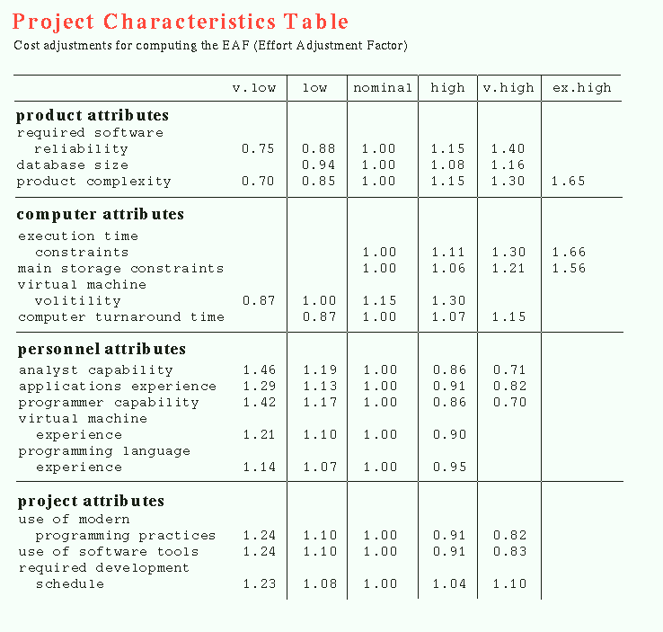

Slide 7
Q. Consider a project having 30,000 lines of code which in an embedded software with critical area hence reliability is high. Find out the estimation?

Slide 8
Solution:
Formula: E = a1 (KLOC)^b1 x (EAF)
The reliability is high, therefore EAF = 1.15
a1 = 2.8 ; b1 = 1.20 for embedded software
E = 2.8 (30) ^1.20 x 1.15 = 191 PM
D = b1(E)^b2
D = 2.5(191)^0.32 = 13 months approx

Slide 9
Q. Consider a project having 45,000 lines of code which in an
Organic software with parameters as:
low database size
nominal virtual machine volatility
High use of software tools
2. semi-detached software with parameters as:
reliability is high.
analyst capability is low.
Programming language experience is nominal
Find out the estimation?

Slide 10
Complete COCOMO model
A major shortcoming of both the basic and intermediate COCOMO models is that they consider a software product as a single homogeneous entity.
However, most large systems are made up several smaller sub-systems.
These subsystems may have widely different characteristics.
For example, some subsystems may be considered as organic type, some semidetached, and some embedded.

Slide 11
Example
A distributed Management Information System (MIS) product for an organization having offices at several places across the country can have the following sub-components:
• Database part
• Graphical User Interface (GUI) part
• Communication part
Of these, the communication part can be considered as embedded software.
The database part could be semi-detached software, and the GUI part organic software.
The cost of these components can be estimated separately and summed up to give the overall cost of the system.

Slide 12
Complete COCOMO (contd)
In other words, the cost of development of each sub-system is estimated separately, and the complete system cost is determined as the subsystem costs.
This approach reduces the margin of error in the final estimate.

Slide 13
Project scheduling
It involves deciding which tasks would be taken up when. Activities undertaken:
1. Identify all the tasks needed to complete the project.
2. Break down large tasks into small activities.
3. Determine the dependency among different activities.
4. Establish the most likely estimates for the time durations necessary to complete the activities.
5. Allocate resources to activities.
6. Plan the starting and ending dates for various activities.
7. Determine the critical path. A critical path is the chain of activities that determines the duration of the project.

Slide 14
Work breakdown structure
Work Breakdown Structure (WBS) is used to decompose a given task set recursively into small activities.
The root of the tree is labeled by the problem name.
Each node of the tree is broken down into smaller activities that are made the children of the node.
Each activity is recursively decomposed into smaller sub-activities until at the leaf level, the activities requires approximately two weeks to develop.

Slide 15
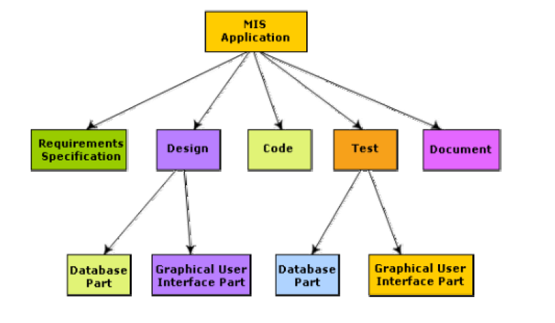
Work breakdown structure of MIS problem

Slide 16
Activity networks and critical path method
WBS representation of a project is transformed into an activity network by representing activities identified in WBS along with their interdependencies.
An activity network shows the different activities making up a project, their estimated durations, and interdependencies.

Slide 17
Slack Time
The slack time (or float time) is the total time that a task may be delayed before it will affect the end time of the project.
The slack time indicates the “flexibility” in starting and completion of tasks.
A critical task is one with a zero slack time. A path from the start node to the finish node containing only critical tasks is called a critical path.

Slide 18
Critical Path Method (CPM)
The minimum time (MT) to complete the project is the maximum of all paths from start to finish.
The earliest start (ES) time of a task is the maximum of all paths from the start to the task.
The latest start time is the difference between MT and the maximum of all paths from this task to the finish.
The earliest finish time (EF) of a task is the sum of the earliest start time of the task and the duration of the task.
The latest finish (LF) time of a task can be obtained by subtracting maximum of all paths from this task to finish from MT.
The slack time (ST) is LS – EF and equivalently can be written as LF – EF.

Slide 19
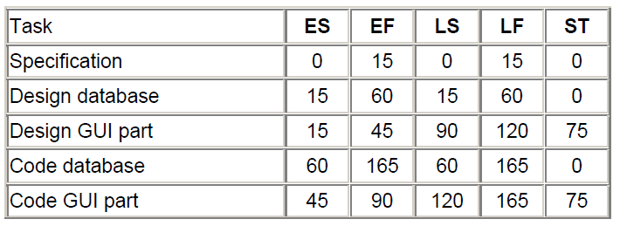

Parameters for different tasks of MIS Problem

Slide 20
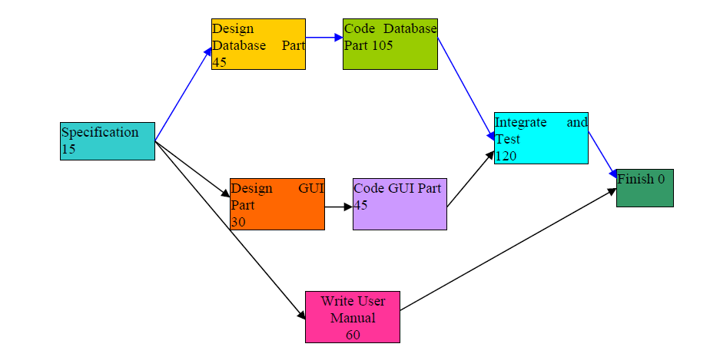
Activity network representation of the MIS problem

Slide 21
Gantt chart
Used to allocate resources to activities (resource planning).
The resources allocated to activities include staff, hardware, and software.
A Gantt chart is a special type of bar chart where each bar represents an activity.
The bars are drawn along a time line.
The length of each bar is proportional to the duration of time planned for the corresponding activity.

Slide 22
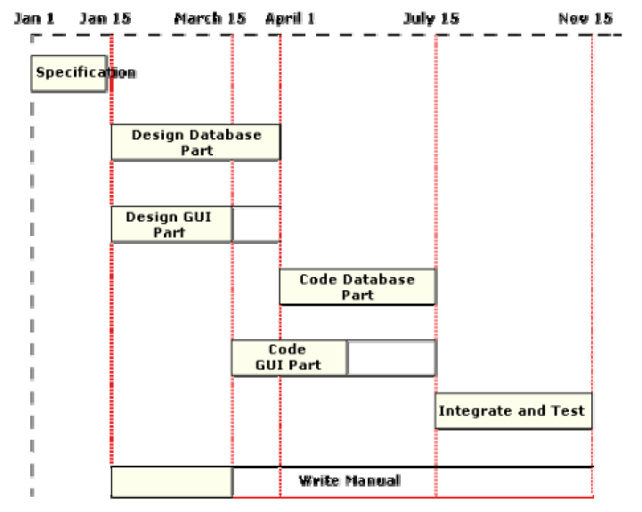
Gantt chart for MIS problem

Slide 23
PERT chart
PERT (Program Evaluation and Review Technique) charts consist of a network of boxes and arrows.
The boxes represent activities and the arrows represent task dependencies.
The boxes of PERT charts are usually annotated with the pessimistic, likely, and optimistic estimates for every task.

Slide 24
Gantt chart representation of a project schedule is helpful in planning the utilization of resources, while PERT chart is useful for monitoring the timely progress of activities.
Also, it is easier to identify parallel activities in a project using a PERT chart.

Slide 25
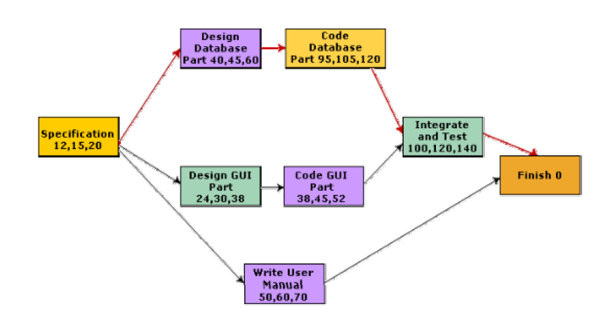
PERT chart representation of the MIS problem

